Slide 1
Number based Programming
WAJP to take user input and print whether the number is Prime number or not.
Q1
Important
Don’t leave it..!!

Slide 2
Number based Programming
WAJP to print and count all the Prime numbers up to a given range.
Q2
Important
Don’t leave it..!!

Slide 3
Number based Programming
WAJP to take user input and print nth prime number.
Q3
Important
Don’t leave it..!!

Slide 4
Number based Programming
WAJP to print all the alternate Prime numbers up to a given range.
o/p:
2 5 11 17….
Or
3 7 13 19
Q4

Slide 5
Number based Programming
WAJP to print and count all prime numbers in a range where sum of digits is also prime number.
[TCS NQT 2024]
Q5

Slide 6
Number based Programming
WAJP to take user input and check the number is palindrome or not.
Q6
Important
Don’t leave it..!!

Slide 7
Number based Programming
WAJP to print and count all the palindrome numbers in a given range.
Q7

Slide 8
Number based Programming
WAJP to take user input and print nth palindrome number.
Q8

Slide 9
Number based Programming
WAJP to print and count all the palindrome numbers in a range which is also a prime number.
Q9

Slide 10
Number based Programming
https://leetcode.com/problems/prime-palindrome/description/
Q10

Slide 11
Number based Programming
WAJP to print and count all the perfect numbers up to 100.
Q11

Slide 12
Number based Programming
WAJP to take user input and print whether the number is Strong number or not.
Q12

Slide 13
Number based Programming
WAJP to print and count all the Strong numbers up to 100.
Q13

Slide 14
Number based Programming
WAJP to take user input and print whether the number is Armstrong number or not.
Q14
Important
Don’t leave it..!!

Slide 15
Number based Programming
WAJP to print and count all the Armstrong numbers up to 100.
Q15

Slide 16
Number based Programming
WAJP to take user input and print whether the number is dissarium number or not.
Q16

Slide 17
Number based Programming
WAJP to print and count all the dissarium numbers up to 1000.
Q17

Slide 18
Number based Programming
Happy Number:
https://leetcode.com/problems/happy-number/
Q18
Good Program!

Slide 19
Number based Programming
WAJP to print and count all the Happy numbers up to 100.
Q19

Slide 20
Number based Programming
WAJP to take user input and print whether the number is Automorphic number or not.
Q20

Slide 21
Number based Programming
WAJP to print and count all the Automorphic numbers up to 100.
Q21

Slide 22
Number based Programming
WAJP to take three user inputs and print LCM of the three numbers.
Q22

Slide 23
Number based Programming
WAJP to take two user inputs and print GCD/HCF of the three numbers.
Q23

Slide 24
Number based Programming
WAJP to convert a decimal number into binary number.
Eg:
i/p: 28
o/p: 11101
Q24

Slide 25
Number based Programming
WAJP to convert a binary number into decimal number.
i/p: 101101
o/p: 45
Q25

Slide 26
Number based Programming
WAJP to convert a decimal number into octal number.
i/p: 235
o/p: 353
Q26

Slide 27
Number based Programming
WAJP to convert an octal number into decimal number.
Q27

Slide 28
Number based Programming
WAJP to convert a decimal number into a hexadecimal number.
Q28

Slide 29
Number based Programming
WAJP to convert a hexadecimal number into a decimal number.
Q29

Slide 30
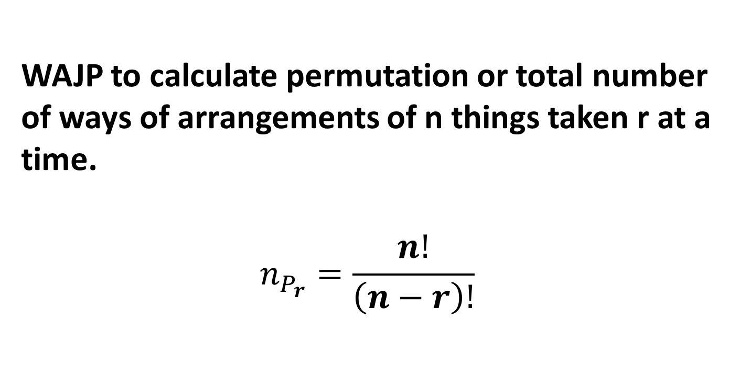
Number based Programming
Q30
WAJP to calculate permutation or total number of ways of arrangements of n things taken r at a time.
$$n_{P_{r}}=\frac{n!}{\left(n−r\right)!}$$

Slide 31
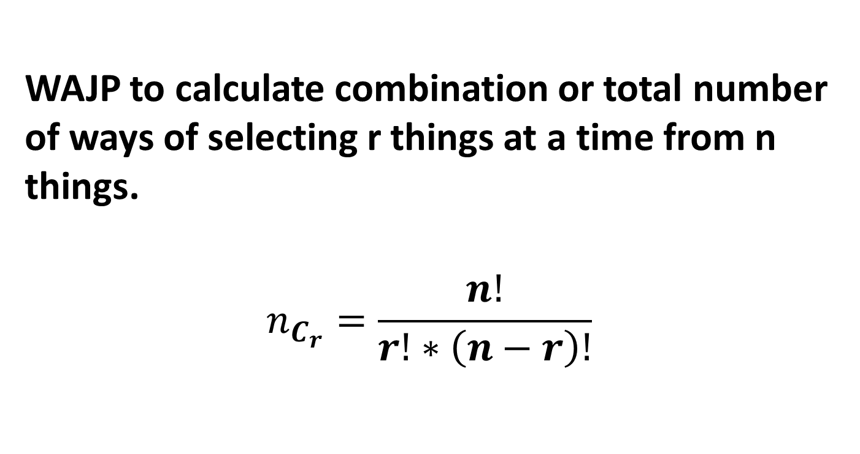
Number based Programming
Q31
WAJP to calculate combination or total number of ways of selecting r things at a time from n things.
$$n_{C_{r}}=\frac{n!}{r!∗\left(n−r\right)!}$$

Slide 32
Number based Programming
WAJP to print nth row of Pascal Triangle.
[Amazon]
Q32

Slide 33
Number based Programming
https://leetcode.com/problems/nth-digit/description/
Q33

Slide 34
Number based Programming
https://leetcode.com/problems/number-of-digit-one/description/
.
Q34

Slide 35
Number based Programming
https://leetcode.com/problems/prime-number-of-set-bits-in-binary-representation/description/
Q35

Slide 36
Number based Programming
You are given an integer number which contains only 1 or 0.
WAJP to shift all 0,s to left side and all 1’s to right side and print it.
i/p: 100111101
o/p:000111111
Q36

Slide 37
Number based Programming
Q37
You are given an integer number. WAJP to shift all even digits to left side and all odd digits to right side and print it.
Input:
N=253687
Output
268537

Slide 38
Number based Programming
Q38
You are given an integer number. WAJP to shift all 0 to left side and all other digits to right side while maintaining the order of the number.
Input:
N=2030680
Output
0002368

Slide 39
Number based Programming
WAJP to take an integer input and replace all 0’s by 1 in a number. [Amazon]
i/p: 41022005;
o/p: 41122115
Q39

Slide 40
Number based Programming
WAJP to take an integer input and replace all 7’s by 0 in a number. [Amazon]
i/p: 41072707;
o/p: 41002000
Q40

Slide 41
Number based Programming
Circular Prime Check:
A Circular Prime is a prime number that remains prime even after rotating its digits.
Example: 197 → 971 → 719 (All are prime).
Write a Java program to check if a number is a Circular Prime or not.
Q41

